Slide 1
An Urban Truck Scheduling and Routing Problem
By Zeyu Liu, Zefeng Lv, Rui Zhou

Slide 2
Introduction
As people and enterprises come under more pressure in a fast-moving and highly connected world, smart logistics play an increasingly important role in improving operational efficiency and enhancing the consumer experience. Reducing costs and increasing logistics efficiency is critical. With the improvement of computational performance, this kind of NP-Hard problem can be better solved by technology developed with optimization algorithms. Our goal is to provide consumers with more straightforward and faster logistics.

Slide 3
Background
AnyLogic Model
Optimization
Assumption
Math Model
How we code
Future to Do

Slide 4

Background
JD is a Chinese e-commerce company headquartered in Beijing. It is one of the two massive B2C online retailers in China by transaction volume and revenue, a member of the Fortune Global 500 and a major competitor to Alibaba.

Slide 5
Background
There is a distributor provides distribution services to 50 customer centers everyday.

Slide 6
DATA
ID | Longitude | Latitude | Pack_ Weight | Pack_ Volume
1 | 116.242043 | 40.072630 | 0.2076 | 0.3666
2 | 116.403595 | 39.872945 | 0.05863 | 0.1687
3 | 116.186289 | 40.016361 | 0.03645 | 0.0745
4 | 116.508011 | 39.826296 | 0.02595 | 0.0542
 | …
50 | 116.130997 | 39.825921 | 0.0198 | 0.1117

Slide 7
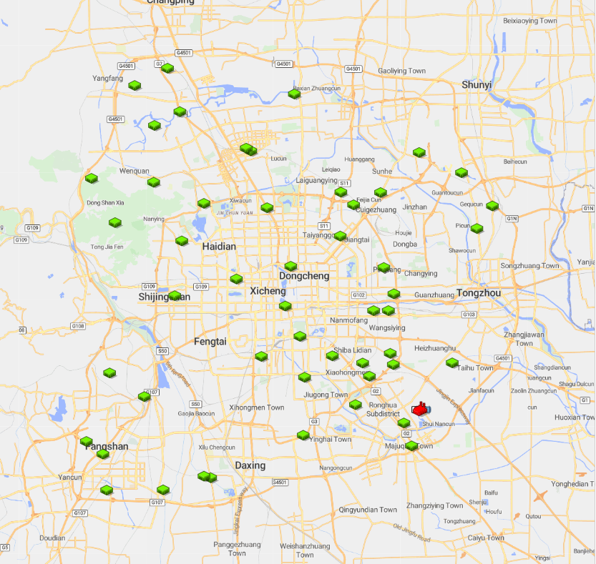
Anylogic Model
GIS MAP
1.Import database
2.Locate distributor and customers

Slide 8
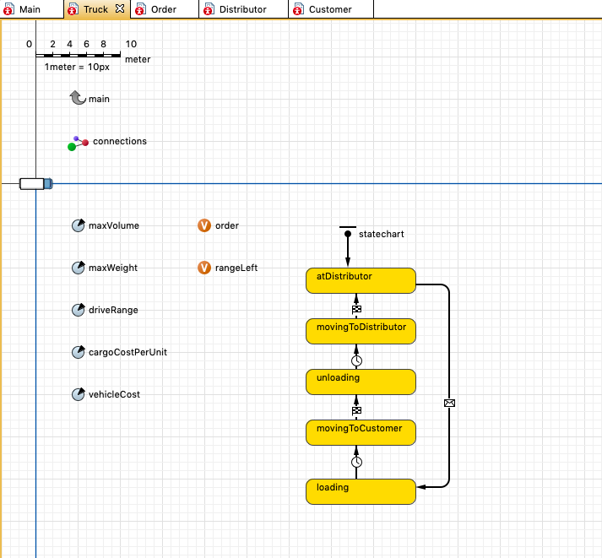
maxVolume=2.5(t)
macWeight=16(m³⁾
driveRange=120,000(m)
cargoCostPerUnit=14$
vehicleCost=300$

Slide 9
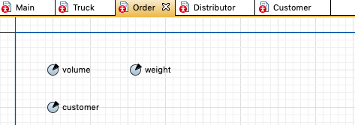
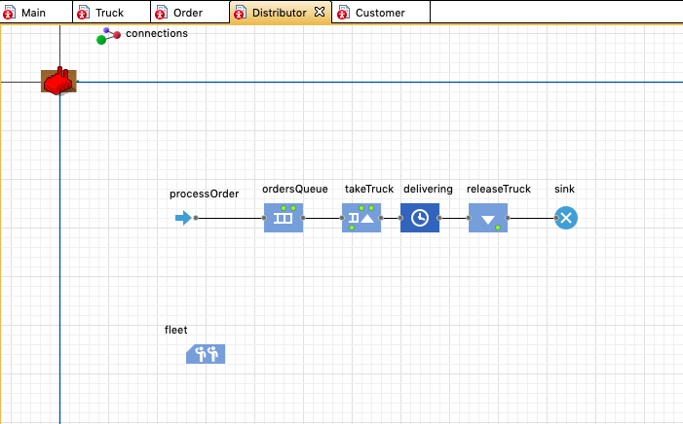

Slide 10
Assumption

Slide 11
Math Model
Decision Variables
Objective Function
Constraints

Slide 12
How we code

Slide 13
Future to Do

